Slide 1
Networking Fundamental
TCP/IP Guide

Slide 2
What Is Network?
A network is a set of hardware devices connected together,
either physically or logically,
using special hardware and software,
to allow them to exchange information.

Slide 3
The value of network
http://www.tcpipguide.com

Slide 4
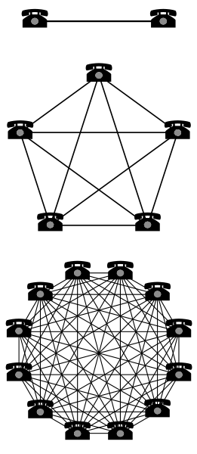
Metcalfe’s law
Two telephones can make only one connection, five can make 10 connections, and twelve can make 66 connections.
Metcalfe's Law is related to the fact that the number of unique connections in a network of a number of nodes (n) can be expressed mathematically as the triangular number n(n − 1)/2, which is proportional to n2 asymptotically

Slide 5
Reed's law
Reed's law is the assertion of David P. Reed that the utility of large networks, particularly social networks, can scale exponentially with the size of the network.
The reason for this is that the number of possible sub-groups of network participants is 2^{N} − N − 1, where N is the number of participants. This grows much more rapidly than either
  the number of participants, N, or
  the number of possible pair connections, N(N − 1)/2 (which follows Metcalfe's law).
so that even if the utility of groups available to be joined is very small on a peer-group basis, eventually the network effect of potential group membership can dominate the overall economics of the system.

Slide 6
Sarnoff's law
Sarnoff's law states that the value of a broadcast network is directly proportional to the number of viewers. It is attributed to David Sarnoff.
For example, a network with 100 members is 10 times as valuable as a network with 10 members.

Slide 7
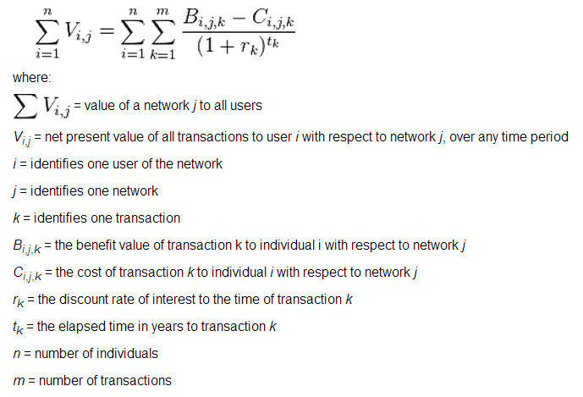
Beckstrom's law
In economics, Beckstrom's law is a model or theorem formulated by Rod Beckstrom and states in summary that "The value of a network equals the net value added to each user’s transactions conducted through that network, summed over all users."
According to its creator, this law can be used to value any network be it social networks, electronic networks, support groups and even the Internet as a whole.^{[1]} This new model values the network by looking from the edge of the network at all of the transactions conducted and the value added to each.

Slide 8
Network technicality

Slide 9
STAR
Router
Switch
Hub
UTP

Slide 10
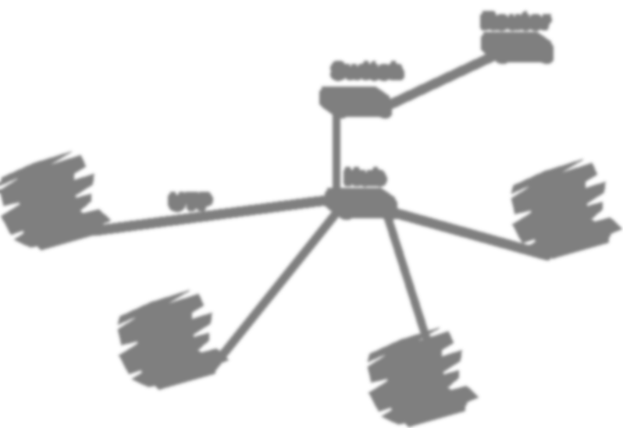
STAR
Advantage
  Easy of Service
  Single Connection
  Centralized Control
Disadvantage
  Central Node
  Difficulty of Expansion

Slide 11
Bus
Router
Serial

Slide 12
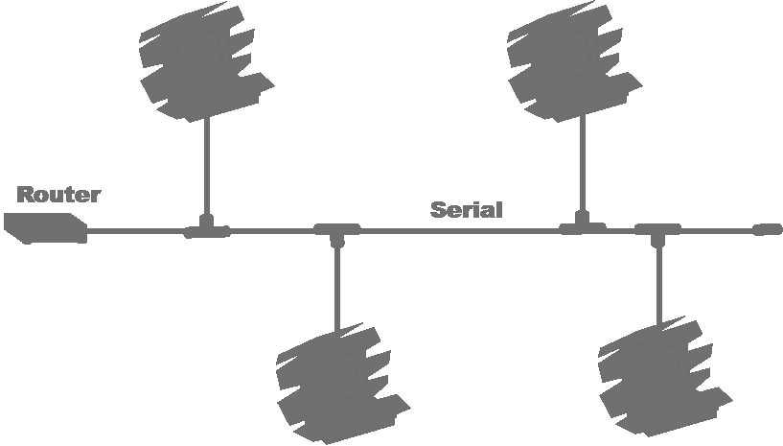
Bus
Advantage
  Relatively less cable
  Easy to extent
  Can be divided into network segment
  No need of hub
Disadvantage
  Fault diagnosis
  Fault Isolation
  Extend the network must be off

Slide 13
Ring
Router

Slide 14
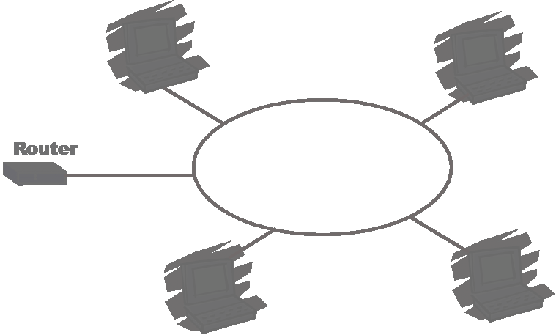
Ring
Advantage
  Relatively Shorter cabling
  Use of FO
Disadvantage
  Node Failure
  Fault Diagnosis
  Fault Isolation
  Extend the network must be off

Slide 15
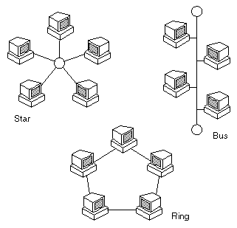
What Is Networking?
Networking is the term that describes the processes involved in
  designing,
  implementing,
  upgrading,
  managing and otherwise
  working with
  networks and network technologies.

Slide 16
The Advantages (Benefits) of Networking
Connectivity and Communication
Data Sharing
Hardware Sharing
Internet Access Sharing
Data Security and Management
Performance Enhancement and Balancing
Entertainment

Slide 17
Connectivity and Communication:
LANs in distant locations can be interconnected into larger wide area networks (WANs).
Individuals within a building or work group can be connected into local area networks (LANs);
  Networks connect computers and the users of those computers.
  Once connected, it is possible for network users to communicate with each other using technologies such as electronic mail.
This makes the transmission of business (or non-business) information
easier,
more efficient and
less expensive
than it would be without the network.
return

Slide 18
Data Sharing:
Before networking was common, an accounting employee who wanted to prepare a report for her manager would have to produce it on his PC, put it on a floppy disk, and then walk it over to the manager, who would transfer the data to her PC's hard disk.
One of the most important uses of networking is to allow the sharing of data.
True networking allows thousands of employees to share data much more easily and quicker.
More so, it makes possible applications that rely on the ability of many people to access and share the same data, such as databases, group software development, and much more.
Intranets and extranets can be used to distribute corporate information between sites and to business partners.
return

Slide 19
Hardware Sharing:
Networks facilitate the sharing of hardware devices.
For example, instead of giving each of 10 employees in a department an expensive color printer, one printer can be placed on the network for everyone to share.
return

Slide 20
Internet Access Sharing:
Small computer networks allow multiple users to share a single Internet connection.
Special hardware devices allow the bandwidth of the connection to be easily allocated to various individuals as they need it, and permit an organization to purchase one high-speed connection instead of many slower ones.
return

Slide 21
Data Security and Management:
Instead of having this data spread over dozens or even hundreds of small computers in a haphazard fashion as their users create it, data can be centralized on shared servers.
In a business environment, a network allows the administrators to much better manage the company's critical data.
This makes it easy for everyone to find the data, makes it possible for the administrators to ensure that the data is regularly backed up, and also allows for the implementation of security measures to control who can read or change various pieces of critical information.
return

Slide 22
Performance Enhancement and Balancing:
Under some circumstances, a network can be used to enhance the overall performance of some applications by distributing the computation tasks to various computers on the network.
return

Slide 23
Entertainment:
The Internet itself offers many sources of entertainment, of course.
Networks facilitate many types of games and entertainment.
Of course, if you are running a business and have easily-amused employees, you might insist that this is really a disadvantage of networking and not an advantage!
In addition, many multi-player games exist that operate over a local area network.
Many home networks are set up for this reason, and gaming across wide area networks (including the Internet) has also become quite popular.
return

Slide 24
The Disadvantages (Costs) of Networking

Slide 25
Here are a few of the items that balance against the advantages of networking:
Setting up a network requires an investment in hardware and software, as well as funds for planning, designing and implementing the network.
Network Hardware, Software and Setup Costs:
Computers don't just magically network themselves, of course.
For a home with a small network of two or three PCs, this is relatively inexpensive, possibly amounting to less than a hundred dollars with today's low prices for network hardware, and operating systems already designed for networks.
For a large company, cost can easily run into tens of thousands of dollars—or more.

Slide 26
Here are a few of the items that balance against the advantages of networking:
In all but the smallest of implementations, ongoing maintenance and management of the network requires the care and attention of an IT professional.
Hardware and Software Management and Administration Costs:
In a smaller organization that already has a system administrator, a network may fall within this person's job responsibilities, but it will take time away from other tasks.
In more substantial organizations, a network administrator may need to be hired, and in large companies an entire department may be necessary.

Slide 27
Here are a few of the items that balance against the advantages of networking:
Undesirable Sharing:
Mitigating these effects costs more time, money and administrative effort
With the good comes the bad; while networking allows the easy sharing of useful information, it also allows the sharing of undesirable data.
One significant “sharing problem” in this regard has to do with viruses, which are easily spread over networks and the Internet.

Slide 28
Here are a few of the items that balance against the advantages of networking:
Illegal or Undesirable Behavior:
Networking facilitates useful connectivity and communication, but also brings difficulties with it.
Typical problems include abuse of company resources, distractions that reduce productivity, downloading of illegal or illicit materials, and even software piracy.
In larger organizations, these issues must be managed through explicit policies and monitoring, which again, further increases management costs.

Slide 29
Here are a few of the items that balance against the advantages of networking:
Data Security Concerns:
If a network is implemented properly, it is possible to greatly improve the security of important data.
In contrast, a poorly-secured network puts critical data at risk, exposing it to the potential problems associated with hackers, unauthorized access and even sabotage.

Slide 30
Networking Layers, Models and Architectures

Slide 31
Networking Layers
Networking technologies are most often compartmentalized in this manner by dividing their functions into layers, each of which contains hardware and/or software elements.
Each layer is responsible for performing a particular type of task, as well as interacting with the layers above it and below it. Layers are conceptually arranged into a vertical stack.
Lower layers are charged with more concrete tasks such as hardware signaling and low-level communication; they provide services to the higher layers.
The higher layers in turn use these services to implement more abstract functions such as implementing user applications.

Slide 32
Networking Models
One other important benefit of layering is that it makes it possible for technologies defined by different groups to interoperate.
For this to be possible, it is necessary for everyone to agree on how layers will be defined and used.
The most common tool for this purpose is a networking model.
  The model describes what the different layers are in the network, what each is responsible for doing, and how they interact.
A universally-accepted model ensures that everyone is on the same page when creating hardware and software.

Slide 33
Networking Models
The most common general model in use today is the Open Systems Interconnection (OSI) Reference Model, which concepts of seven stacked layers.
These range from the Physical Layer (layer one) at the bottom, which is responsible for low-level signaling, to the Application Layer (layer seven) at the top, where application software is implemented.
Understanding the OSI model is essential to understanding networking as a whole.

Slide 34
Networking Architectures
Closely related to the concept of a model is that of an architecture.
An architecture is essentially a set of rules that describes the function of some portion of the hardware and software that constitute a stack of layers.
Such a rule-set usually takes the form of a specification or standard that describes how equipment and programs using the technology must behave.
A networking architecture is designed to implement the functions associated with a particular contiguous set of layers of the OSI Reference Model, either formally or informally.

Slide 35
Protocols: What Are They, Anyway?

Slide 36
protocol
reference to
networking protocols,
internetworking protocols,
high-level protocols,
low-level protocols,
protocol stacks,
protocol suites,
sub-protocols,
and so on.

Slide 37
The Meaning of the Word “Protocol”
a protocol is basically a way of ensuring that devices are able to talk to each other effectively.
In most cases, an individual protocol describes how communication is accomplished between one particular software or hardware element in two or more devices.
In the context of the OSI Reference Model, a protocol is formally defined as a set of rules governing communication between entities at the same Reference Model layer.
For example, the Transmission Control Protocol (TCP) is responsible for a specific set of functions on TCP/IP networks.
Each host on a TCP/IP network has a TCP implementation, and they all communicate with each other logically at layer four of the OSI model.

Slide 38
Different Uses of the Word “Protocol”
For example, TCP/IP is often called just a “protocol” when it is really a (large) set of protocols.
Protocol Suites: It is very common to hear the word “protocol” used to refer to sets of protocols that are more properly called protocol suites (or stacks, in reference to a stack of layers).
Sometimes, the name of the technology itself leads to this confusion.
The Point-to-Point Protocol (PPP), for example, is not one protocol; it contains many individual protocols that serve different functions and even have distinct message formats. Thus, PPP is really a protocol suite, or alternately, can be considered a protocol with “sub-protocols”.

Slide 39
Different Uses of the Word “Protocol”
Microsoft Windows Protocols:
One important example of the issue of referring to protocol suites as single protocols is the networking software in Microsoft Windows.
It usually calls a full networking stack like TCP/IP or IPX/SPX just a “protocol”.
When you install one of these “protocols”, however, you actually get a software module that supports a full protocol suite.

Slide 40
Different Uses of the Word “Protocol”
Other Technologies:
Sometimes technologies that are not protocols at all are called protocols, either out of convention or perhaps because people think it sounds good.
  For example, TCP/IP Remote Network Monitoring (RMON) is often called a protocol when it is really just an enhancement to the Simple Network Management Protocol (SNMP)—which is a protocol!

Slide 41
Messages: Packets, Frames, Datagrams and Cells

Slide 42
Packet switching
Many networking technologies are based on packet switching, which involves the creation of small chunks of data to be sent over a network.
Even though the word “packet” appears in the name of this method, the data items sent between networked devices are most generically called messages.
“Packet” is one of a variety of similar words that are used in different contexts to refer to messages sent from one device to another.

Slide 43
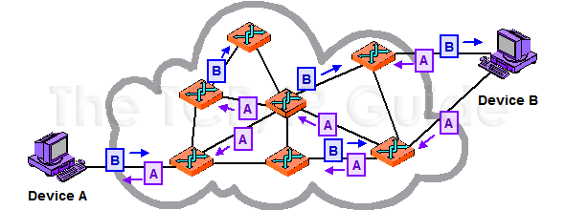
Packet Switching
In a packet-switched network, blocks of data, even from the same file or communication, may take any number of paths as it journeys from one device to another

Slide 44
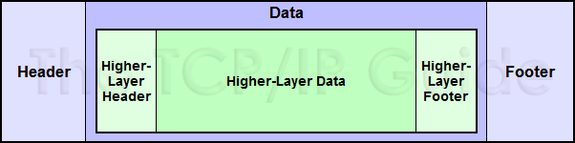
Network Message Formatting
In the most general of terms, a message consists of a data payload to be communicated, bracketed by a set of header and footer fields.

Slide 45
Message Transmission Methods
Unicast Messages:
These are messages that are sent from one device to another device; they are not intended for others.
If you have a friend at this social event, this is the equivalent of pulling him or her aside for a private conversation.
Of course, there is still the possibility of someone else at the event overhearing your conversation—or even eavesdropping on it.
The same is true in networking as well—addressing a message to a particular computer doesn't guarantee that others won't also read it, just that they normally will not do so.

Slide 46
Message Transmission Methods
Broadcast Messages:
As the name suggests, these messages are sent to every device on a network.
They are used when a piece of information actually needs communicating to everyone on the network, or used when the sending station needs to send to just one recipient, but doesn't know its address.
  For example, suppose a new arrival at the social gathering saw a blue sedan with New Hampshire plates in the parking lot that had its lights left on.
  He of course does not know whose car this is.
  The best way to communicate this information is to broadcast it by having the host make an announcement that will be heard by all, including the vehicle’s owner.
  In networks, broadcast messages are used for a variety of purposes, including finding the locations of particular stations or the devices that manage different services.

Slide 47
Message Transmission Methods
Multicast Messages:
These are a compromise between the previous two types: they are sent to a group of stations that meet a particular set of criteria.
These stations are usually related to each other in some way, such as serving a common function, or being set up into a particular multicast group.

Slide 48
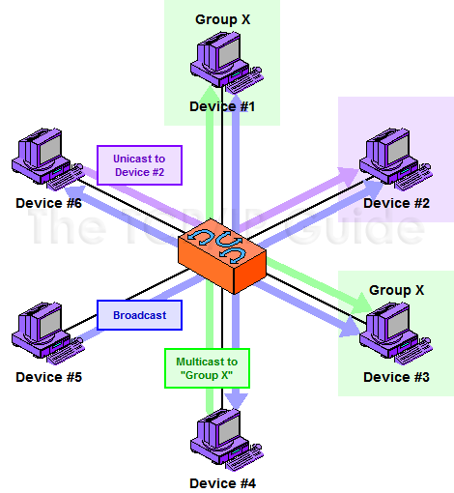
Message Transmission Methods

Slide 49
Network Structural Models and Client/Server and Peer-to-Peer Networking

Slide 50
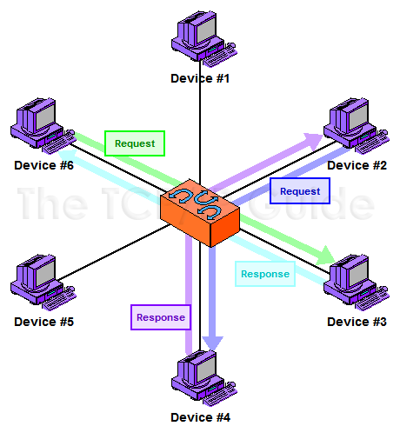
Peer-to-Peer Networking
In this model, each device on the network is treated as a peer, or equal.
Each device can send requests and responses, and none are specifically designated as performing a particular role.
This model is more often used in very small networks.

Slide 51
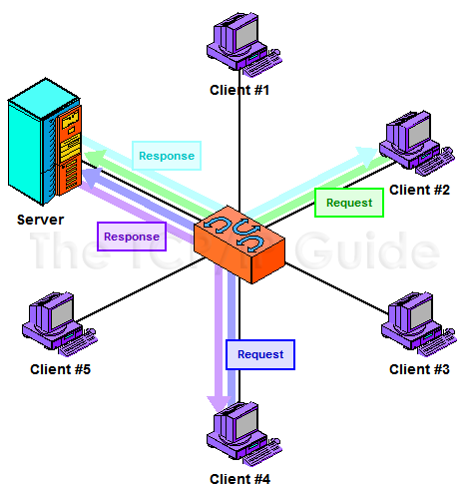
Client/Server Networking
In the client/server model, a small number of devices are designated as servers and equipped with special hardware and software that allows them to more efficiently interact simultaneously with multiple client machines.
While the clients can still interact with each other, most of the time they send requests of various sorts to the server, and the server sends back responses to them.

Slide 52
Types and Sizes of Networks

Slide 53
Fundamental Network Classifications
three general classes:
Local Area Networks (LANs): Networks that connect together computers that are relatively close to each other—generally, within the same room or building.
Wireless Local Area Networks (Wireless LANs or WLANs): Local area networks that connect devices without wires, using radio frequencies or light.
Wide Area Networks (WANs): Networks that connect together devices or other networks over a greater distance than is practical for local area networking.
More often than not, WANs are used to link together physically distant LANs.
For example, a company with locations in two different cities would normally set up a LAN in each building and then connect them together in a WAN. I also consider most Internet access technologies to be a form of wide area networking, though some might not agree with that.
There is also the term wireless WAN (WWAN), which just refers to a WAN that uses wireless technology.

Slide 54
"Intermediate" Network Types
The blurry line between LAN and WAN is becoming more muddled every years. One reason is the emergence of “intermediate” network types that straddle the line between these more familiar terms.
Campus Area Networks (CANs): A campus area network (CAN) is one created to span multiple buildings in the same location, such as the campus of a university. Campus area networking is a “gray area”, since neither LANs nor WANs alone are always well-suited for this type of application. Often, a mix of LAN and WAN techniques are used for campus networking, depending on the characteristics of the campus and the needs of the organization.
Metropolitan Area Networks (MANs): As the name implies, this refers to a network that spans a particular small region or a city. Metropolitan area networks can be considered either as “small WANs” that cover a limited geographical area, or as “large LANs” that cover an area greater than that normally associated with a local network. Wireless metropolitan area networks are of course sometimes called WMANs; IEEE 802.16 is an example of a WMAN standard.

Slide 55
Personal Area Networks (PANs)
This type of network generally means a very small LAN with a range of only a few feet, intended mostly to connect together devices used by a single person (or very small group).
The term is most commonly used in reference to Bluetooth / IEEE 802.15 wireless technology, so you will sometimes see the terms wireless personal area network (WPAN) and just PAN used interchangeably.

Slide 56
The Internet, Intranets and Extranets

Slide 57
Internet
The Internet is defined not just as the computers that are connected to each other around the world, but as the set of services and features that it offers.
More than that, the Internet defines a specific way of doing things, of sharing information and resources between people and companies

Slide 58
Intranet
As Internet use and popularity exploded in the 1990s, many people realized that the techniques and technologies used on the Internet would be useful if applied to internal company networks as well.
The term intranet was coined to refer to an internal network that functioned like a “private Internet”.
It comes from the prefix “intra”, which means “within”.
Most intranets are internetworks as well!

Slide 59
Extranet
If an intranet is “extended” to allow access to it not only strictly from within the organization, but also by people or groups outside the main company, this is sometimes called an extranet.
“Extra” of course, is a prefix that means “outside” or “beyond

Slide 60
Networking Standards

Slide 61
All networking technologies have standards associated with them.
These are usually highly technical documents, and often presume that the reader has a fair bit of knowledge about networking.
If you aren't an expert, you will probably have some difficulty understanding networking standards.

Slide 62
International Networking Standards Organizations
International Organization for Standardization (ISO): Probably the biggest standards organization in the world, the ISO is really a federation of standards organizations from dozens of nations. In the networking world, the ISO is best known for its OSI Reference Model.
American National Standards Institute (ANSI): ANSI is the main organization responsible for coordinating and publishing computer and information technology standards in the United States. While they are commonly thought of as developing and maintaining standards, they do neither. Instead, they oversee and accredit the organizations that actually create the standards, qualifying them as Standards Developing Organizations or SDOs. ANSI also publishes the standards documents created by the SDOs, and serves as the United States' representative to the ISO.
Information Technology Industry Council (ITIC): ITIC is a group of several dozen companies in the information technology (computer) industry. ITIC is the SDO approved by ANSI to develop and process standards related to many computer-related topics. It was formerly known as the Computer and Business Equipment Manufacturers Association (CBEMA).

Slide 63
International Networking Standards Organizations
National Committee for Information Technology (NCITS): A committee established by the ITIC to develop and maintain standards related to the information technology world. NCITS was formerly known by the name Accredited Standards Committee X3, Information Technology, or more commonly, just X3. It maintains several sub-committees that develop and maintain standards for various technical subjects.
Institute of Electrical and Electronics Engineers (IEEE): The IEEE (pronounced “eye-triple-ee”) is a well-known professional organization for those in the electrical or electronics fields, including computers and networking. IEEE's main claim to fame in the networking industry is the IEEE 802 Project, which encompasses many popular networking technologies including Ethernet.
Electronic Industries Alliance (EIA): The EIA is an international industry association that is best known for publishing electrical wiring and transmission standards.

Slide 64
International Networking Standards Organizations
Telecommunications Industry Association (TIA): The TIA is the communications sector of the EIA, and is responsible for developing communications standards. Since communications, wiring and transmission are all related, and since the TIA and EIA organizations are also related, standards produced by the EIA or TIA are often labeled with the combined prefixes “EIA/TIA” or “TIA/EIA”.
International Telecommunication Union - Telecommunication Standardization Sector (ITU-T): ITU-T is another large international body that develops standards for the telecommunications industry. The ITU-T was formerly named the International Telephone and Telegraph Consultative Committee or CCITT (the abbreviation was of the French version of the organization's name, Comité consultatif international téléphonique et télégraphique.)
European Telecommunications Standards Institute (ETSI): An organization with members from dozens of countries both within and outside Europe that is dedicated to developing telecommunications standards for the European market (and elsewhere). ETSI is known for, among other things, regulating the use of radio bandwidth in Europe and developing standards such as HiperLAN.

Slide 65
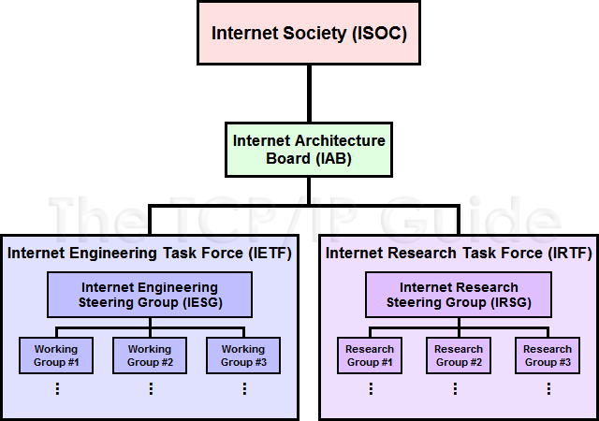
Internet Standards Organizations (ISOC, IAB, IESG, IETF, IRSG, IRTF)

Slide 66
Backgrounder: Data Representation

Slide 67
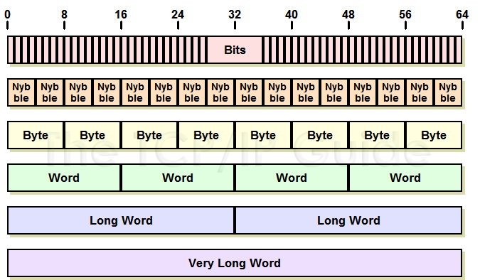
Binary Information Representations and Terms

Slide 68
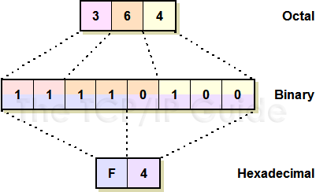
Binary, Octal and Hexadecimal Number Representations
A binary number can be represented in octal form by grouping its bits into sets of three, or in hexadecimal by using sets of four bits.
These base-8 and base-16 numbers have the advantage of being far shorter than binary numbers, and hence much easier to work with.

